Slide 1
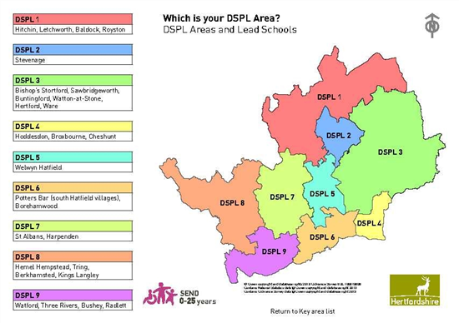

Core Offer
The county is divided into 9 DSPL areas
All DSPL areas deliver core services that meet the county priorities. These are similar across all areas though providers may vary
Part of the DSPL budget is directed towards meeting local needs
Each area has a board which includes Head-Teachers, Local Authority professionals and parents
DSPLs were seen as a strength in the 2023 local authority Ofsted inspection

Slide 2
A partnership approach where parents, staff in Early Years Settings and Schools, FE colleges, LA officers and reps. from other agencies work together as part of an area group with the intention of :
- Meeting Needs as Close to home as possible for CYP with SEND 0-25
- Improving outcomes for wellbeing and attainment
- Removing barriers to learning
- Using resources more effectively
DSPL Aims

Slide 3
How it operates at a local level
Local Board oversees the delivery of a strategic Plan
Manager identifies local need through a variety of means including gathering and analysis of data from schools, parents, LA, training etc
Manager develops strategic plan
Manager and SEND Lead ensure that local initiatives are delivered and work closely with schools to develop inclusion and help with individual cases, in what could be described as an Area SENCo
Operating at a local level

Slide 4
Planning in Line with the Strategy 2022 – 2025
Put in a pic
All schools, EY settings and services deliver quality provision that meets the needs of CYP with SEND locally
Short and long term outcomes for children with SEND are improved
DSPLs will ensure consistent provision to achieve the best outcomes at a local level for CYP and schools
DSPLs facilitate collaborative working at a local level between all stakeholders
Local Authority SEND strategic priorities are fully understood and met locally
Strategic Outcomes

Slide 5
Some examples of how this translates into local planning
Support mainstream schools and settings to deliver quality provision that meets the needs of CYP with SEND, including:
- CYP awaiting a special school place
- CYP with SEMH needs, including EBSA
- CYP on reduced or part-time timetables
- CYP out of school/EHE/missing from education/ excluded or suspended
Elements that the DSPLs have to include in their strategic plan:
Planning in line with the SEND Strategy

Slide 6
What does this look like at a local level?
DSPLs provide a variety of activities which include::
- Commissioning training
- Supporting cross-phase transitions
- Supporting settings, families and young people
- Analysis of local and county data
- Identifying local needs and providing support
- Running SENCo Forums and clusters
- Working alongside LA, health and CS professionals
- Managing the local funding panel and budget
- Supporting the implementation and roll-out of pilot projects
What this can look like at a local level

Slide 7
What does this look like at a local level?
-
-
-
-
-
-
-
-
-
What we do in DSPL_

Slide 8
What does this look like at a local level?
-
-
-
-
-
-
-
-
-

Slide 9
What does this look like at a local level?
-
-
-
-
-
-
-
-
-

Slide 10
What does this look like at a local level?
-
-
-
-
-
-
-
-
-

